Slide 1
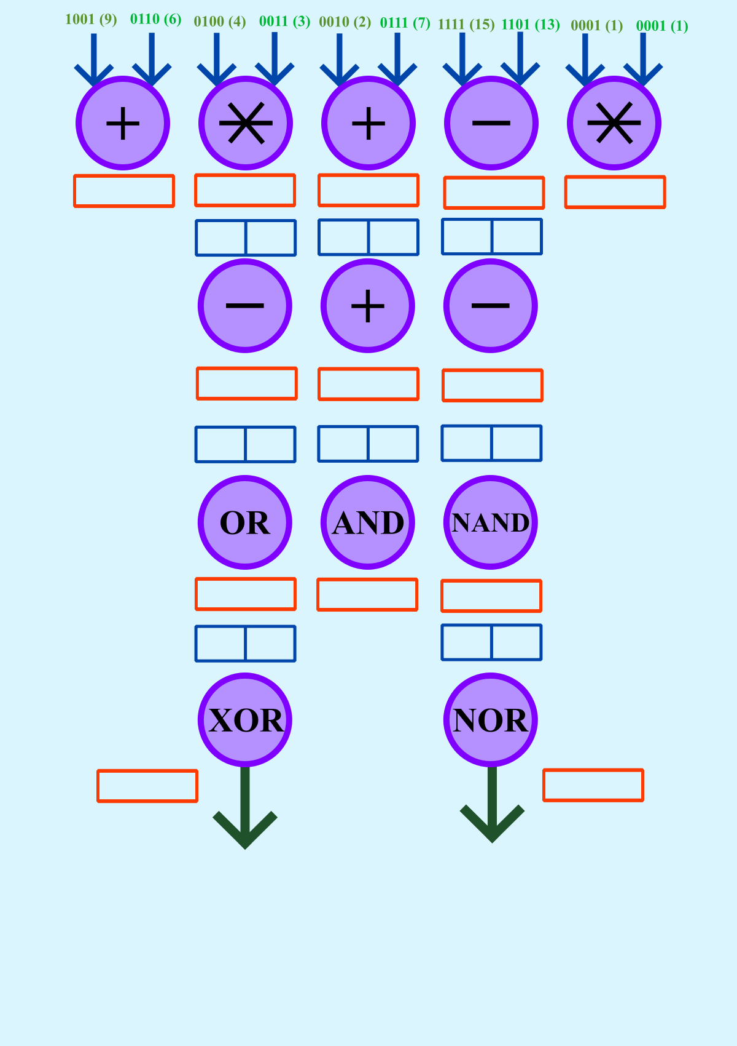
S1=1111
S2=1100
S3=1001
S4=0010
S5=0001
S1 S3
S3 S5
S2 S4
S6=0110
S7=1010
S8=1010
S6 S8
S7 S8
S6 S9
S11=1110
S12=1010
S13=0111
S11 S12
S12 S13
S21=0100
S22=0000

Slide 2
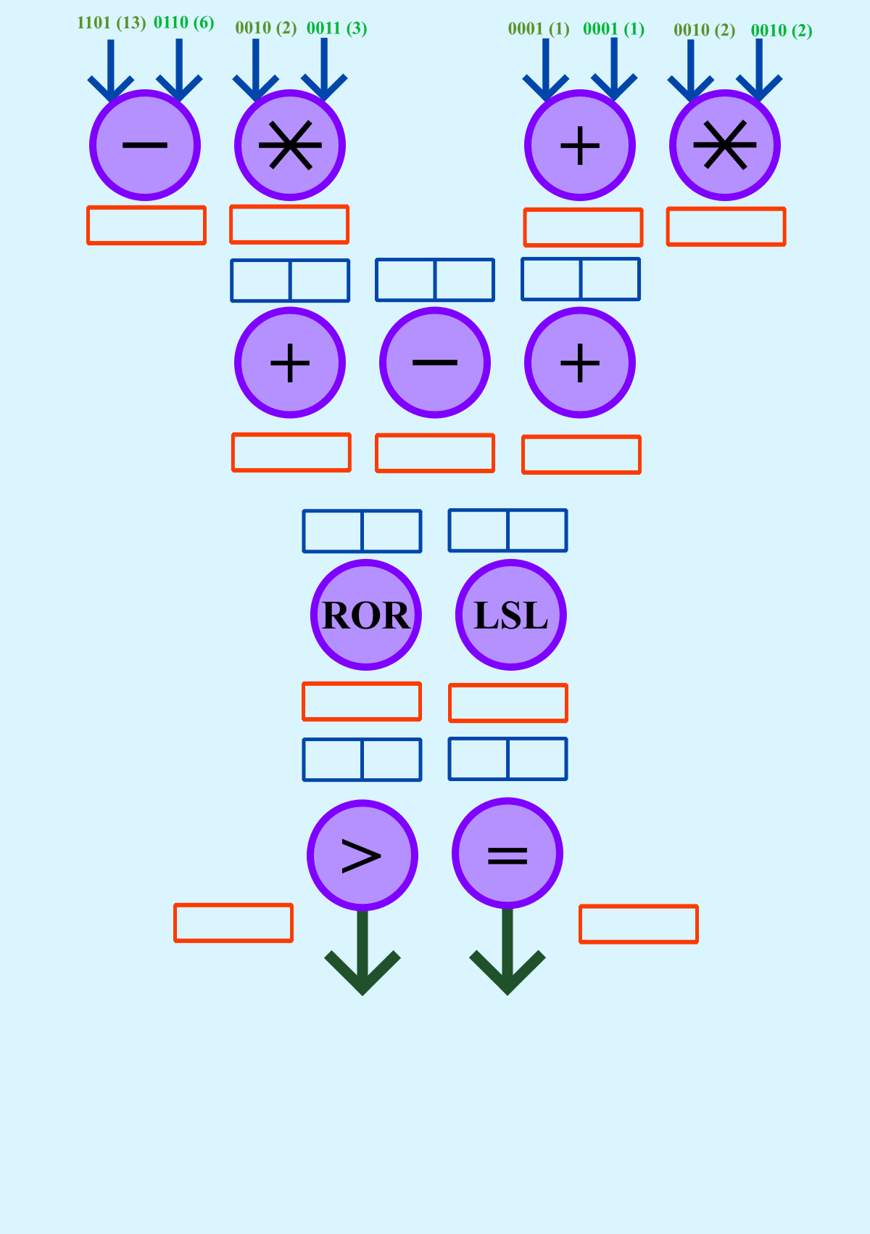
S1=0111
S2=0110
S4=0010
S5=0100
S1 S4
S1 S5
S2 S5
S7=1001
S8=0011
S9=1010
S6 S9
S7 S10
S11=1101
S13=0100
S11 S13
S11 S12
S16=1111
S17=0000

Slide 3
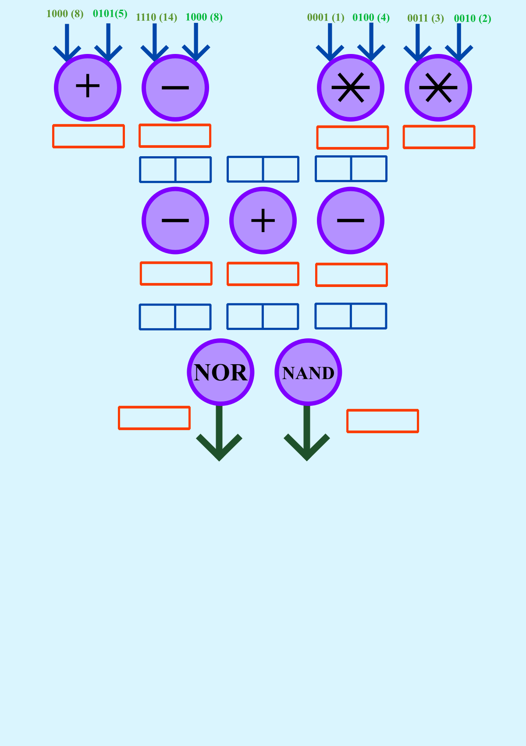
S1=1101
S2=0110
S3=0100
S4=0110
S1 S2
S2 S4
S2 S4
S6=0111
S8=1100
S9=0000
S6 S7
S8 S9
S11=0000
S12=1111

Slide 4
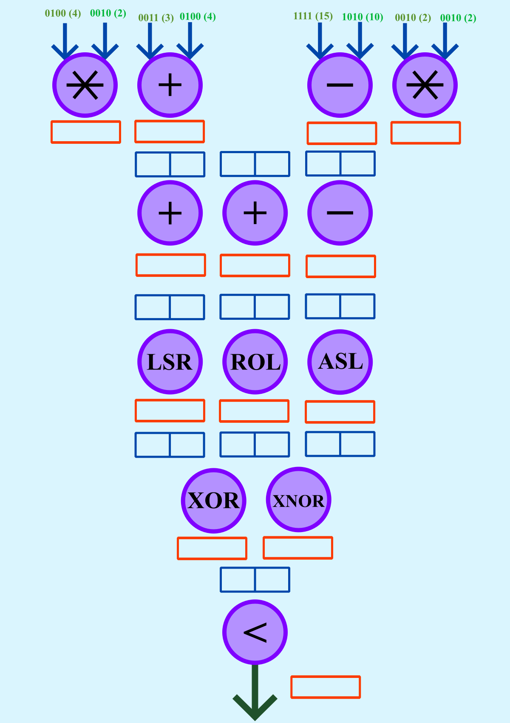
S1=1000
S2=0111
S3=0101
S4=0100
S1 S3
S2 S4
S3 S4
S6=1101
S7=1011
S8=0001
S6 S7
S6 S8
S7 S8
S11=0000
S12=1011
S13=0110
S11 S12
S12 S13
S16=1011
S17=0010
S16 S17
S21=0000

